Slide 1
What are Victimization Surveys and How to Use Them?
Professor Mike Hough
ICPR, University of London
Improvement of Civilian Oversight of Internal Security Sector Project - Phase II – Istanbul - 26-27 March 2013

Slide 2
What I’ll discuss
Using surveys to improve civilian oversight
Measuring victimisation, as experienced by citizens (eg ICVS)
Measuring trust in justice, in the eyes of citizens (eg European Social Survey) – to be discussed by Dr Sato

Slide 3
The case for surveys in justice
To be effective the police and the courts need public and trust and legitimacy
So the police and the justice system must understand public experience and attitudes
Surveys can provide this directly
By speaking to representative samples
Nationally or locally
Most European countries now use surveys for justice policy

Slide 4
Some issues for surveys
Different modes of surveying
Face to face (in the home)
Phone surveys
Internet
Different types of sampling
Probability samples drawn from population lists
Quota samples
Response rates
Sample size, sampling error and precision

Slide 5
The case for victimisation surveys
Police statistics can be a bad guide to crime
Not all crimes are reported to police
Not all reported crimes are recorded
When the police are trusted, people will report crimes they have experienced
When people distrust the police, they will be less likely to report crime
And police recording rates vary
So low recorded crime rates can mislead

Slide 6
How surveys of victimisation work
“In the last twelve months, has anyone got into your house and stolen something?”
“In the last twelve months, has anyone attacked you or hit you in any way?”
“etc etc
“Did you report this to the police?”
Enables measures of:
Reported crime
Unreported crime
All crime

Slide 7
Surveys of victimisation
US National Crime Victimisation Survey
UK Crime Survey for England and Wales
Netherlands Victimisation Survey
France, Germany, Sweden…….
International Crime Victimisation Survey (ICVS & EU-ICS)

Slide 8
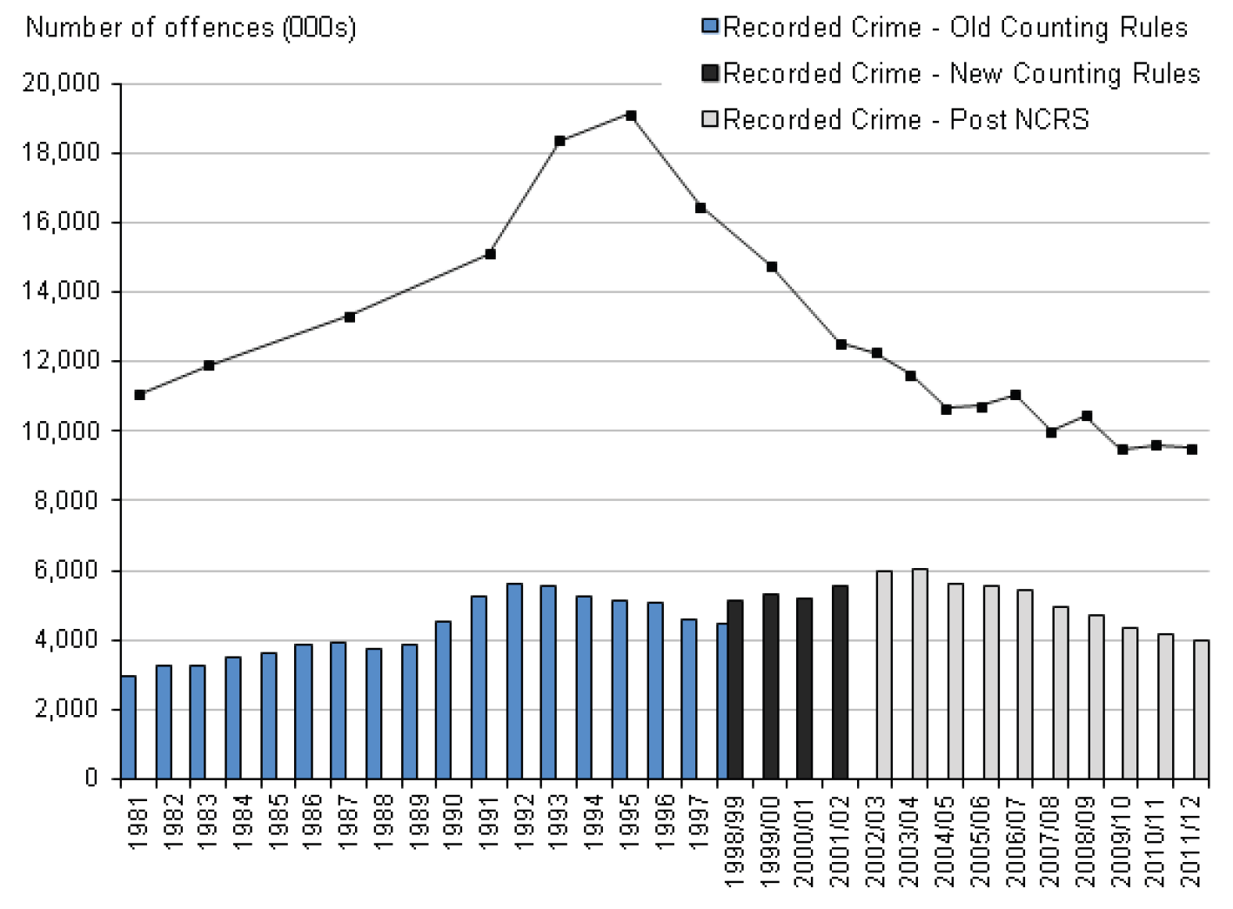
Crime trends, England and Wales
⬇
⬇

Slide 9
Reporting rates – by crime type, England and Wales, 2010/11

Slide 10
Attrition in the criminal process England and Wales
Notes:
No new data

Slide 11
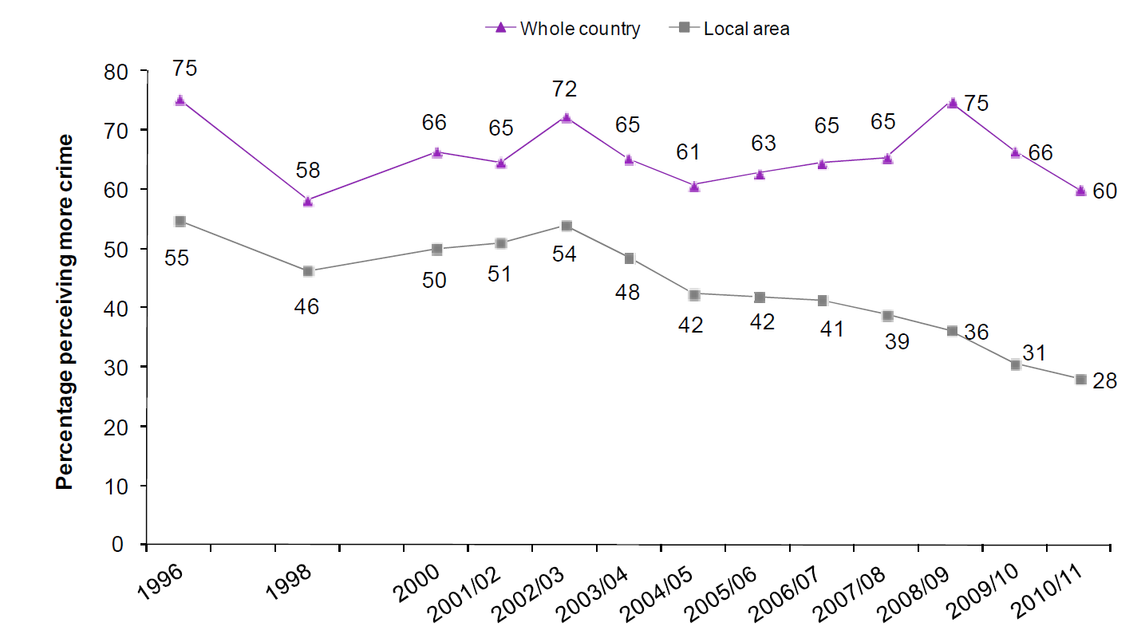
Perceptions of changing crime, 1996-2011

Slide 12
ICVS, 2005
No correlation between recorded crime rates and victim survey rates between countries
40 countries
No clear correlation between development and crime rates
But rich industrialised countries record a high proportion of their crime
Ex-communist block countries record a low proportion

Slide 14
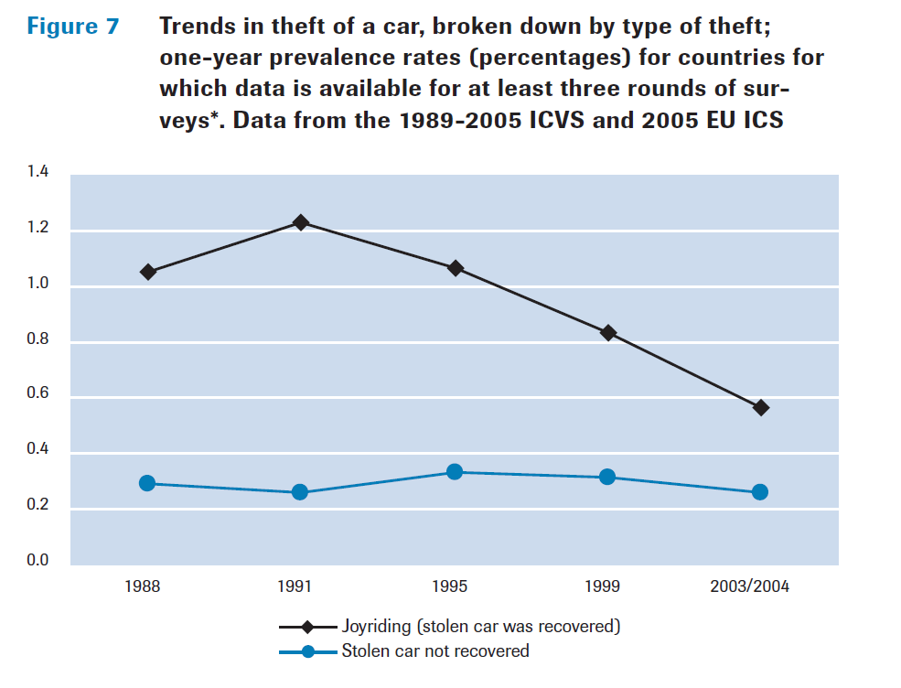
Graphic for ICVS

Slide 15
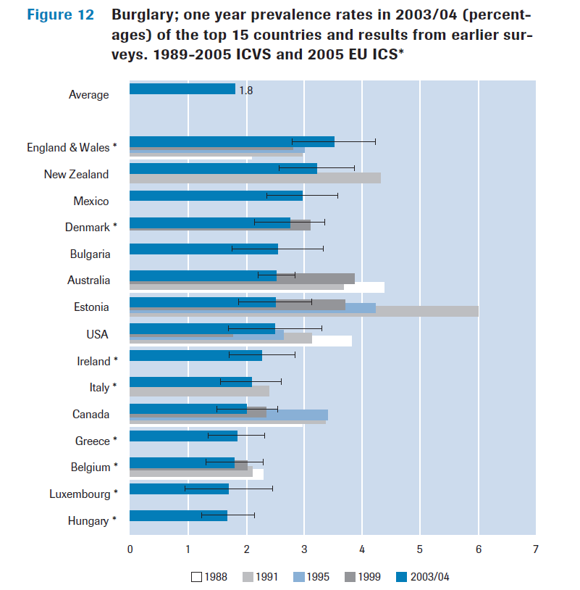

Slide 16
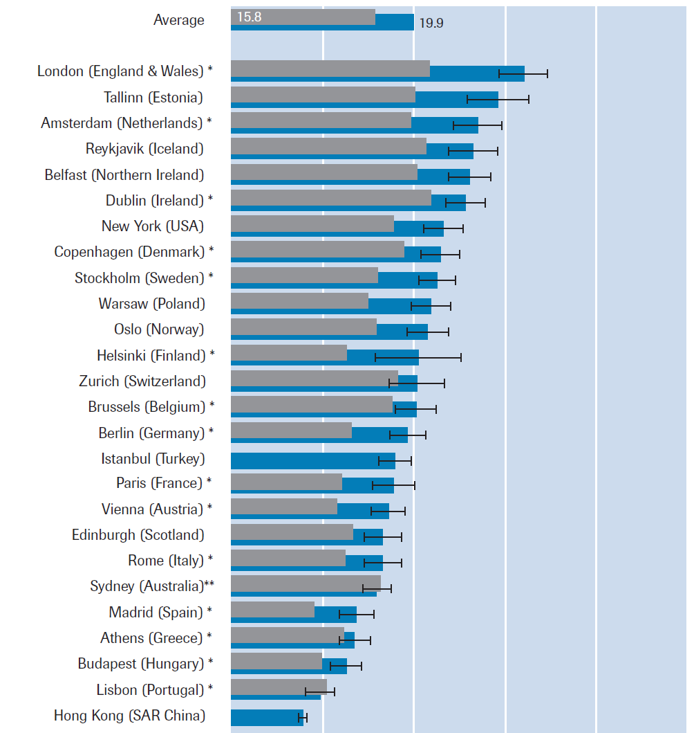
Overall crime (ten offences) in city samples, 2005 ICVS/EU-ICS

Slide 17
What are Victimization Surveys and How to Use Them?
Professor Mike Hough
ICPR, University of London
Improvement of Civilian Oversight of Internal Security Sector Project - Phase II – Istanbul - 26-27 March 2013

