Slide 1
Launch Event
Sebastian Roché
Chief Technical Advisor
ICOISS Phase 2
A project implemented by the Ministry of Interior
with the technical assistance of UNDP Turkey,
Funded by the EU

Slide 2
The Return of ICOISS
Police and oversight
What defines a police force is the fact that it is instituted and overseen by a superior authority.
What defines democratic oversight is the means through which police are overseen.

Slide 3
Benefits for all stakeholders
Citizens needs are taken into account in a systematic way,
Ministry of Interior exercize the powers given by law,
ISFs increase: 1/ trust and confidence in the public, 2/ capacity to interact with citizen, 3/ legal security (clear accountability rules).

Slide 4
Second Phase
Not trivial
A desire to go further
Bigger
Touching most dimensions of SSR
The most ambitious project in the mediterranean region
In the most sophisticated country doing SSR

Slide 5
How did it all start?
The true story:
2005
2008-2010
2012-2014

Slide 6

2005

Slide 7

2009

Slide 8
2008-2010
Systematic review of CO
New tools for Governors and police
New vision for all ISFs under « one roof »
New administrative practices+polls
Understanding of Gendarmerie
in comparative perspective
Ex: New Joint College of
perfectionment

Slide 9
The dimensions for defining a police force with a military status
Gendarmerie
Affiliation of force
Liabiity before courts
Status of agents

Slide 10
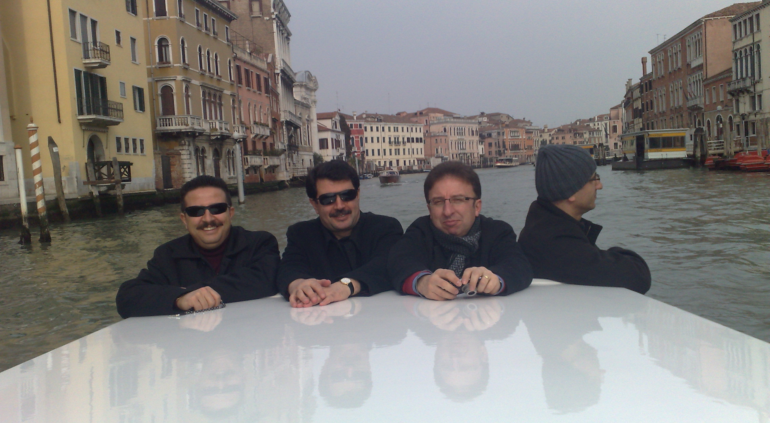
A lot of efforts, long lasting meetings

Slide 11
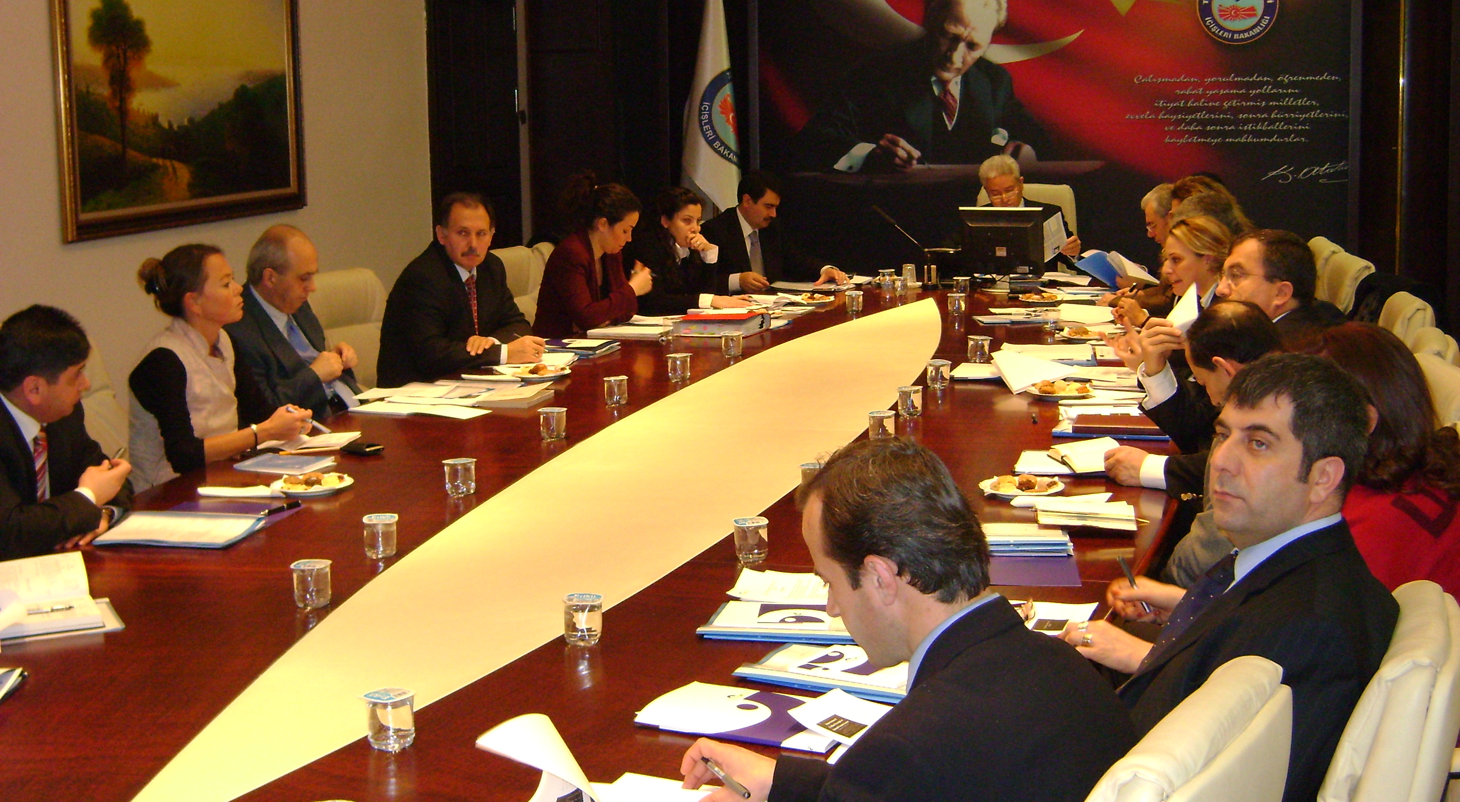
A lot of efforts, long lasting meetings

Slide 12
2012 - 2014
Larger implementation of Local Security Commission for citizen participation (with legislation),
Turning ideas into concrete projets (College for perfectionning of high level police/gendarmes; national opinion poll for monitoring citizen satisfaction),
Strenghening civilian oversight principles in one piece of legislation (Framework law for the ISS),
Going deeper into Parliamentary oversight through systematic comparisons accross states

Slide 13
Conclusion
2008 – 2010: forging the concepts
2012-2014: implementing changes

